Slide 1
Working with the Android Services
Nilanjan Banerjee
University of Maryland, Baltimore County
nilanb@umbc.edu
WWW: http://www.csee.umbc.edu/~nilanb/teaching/628/
Introduction to Mobile Computing

Slide 2
What is and is not an Android service?
A service is not a separate process
A service is not a separate thread!
A facility for an application to tell the system about something it wants to do be doing in the background (Context.startService())
A facility for an application to expose some functionality that other applications can use (Context.bindService())

Slide 3
Uses of Android Services
Expose services that applications can use
getSystemService() and use of Managers (locationManager())
Bind to your own services
Create your own activity
Interact with services from activity

Slide 4
Broadcast Receiver
Registered as a receiver in an Android application via AndroidManifest.xml
Service sends out Intent using sendBroadcast() method while the BroadcastReceiver defines a method called onReceive() to receive the Intent
Example: Application which listens for changes in the phone state
<manifest>
<application>
<receiver android:name=“MyPhoneReceiver”>
<intent-filter>
<action android:name=“android.intent.action.PHONE_STATE> </action>
</intent-filter>
</receiver>
<uses-permission android:name=“android.permission.READ_PHONE_STATE”></uses-permission>
</application>
</manifest>

Slide 5
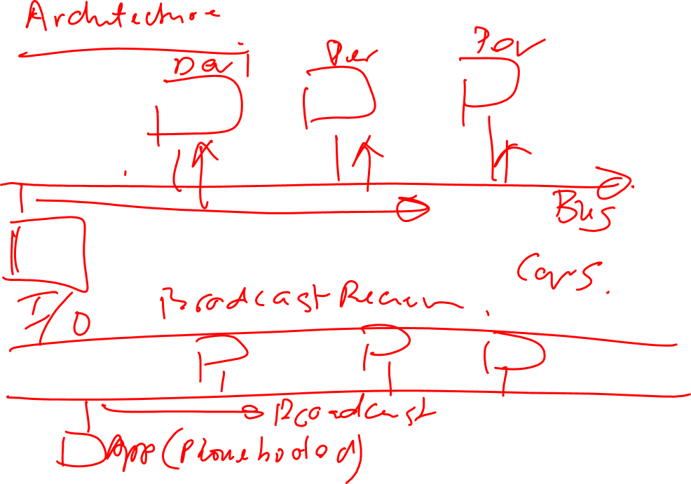

Slide 6
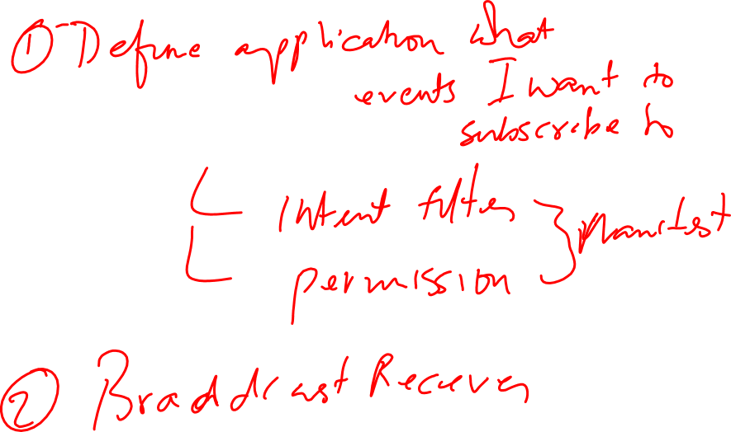

Slide 7


Slide 8
Broadcast Receiver: Phone state example
import android.content.BroadcastReceiver;
import android.content.Context;
import android.content.Intent;
mport android.os.Bundle;
import android.telephony.TelephonyManager;
import android.util.Log;
public class MyPhoneReceiver extends BroadcastReceiver
{
@Overridepublic
void onReceive(Context context, Intent intent)
{
Bundle extras = intent.getExtras();
if (extras != null)
{
String state = extras.getString(TelephonyManager.EXTRA_STATE);
Log.w("DEBUG", state);
if (state.equals(TelephonyManager.EXTRA_STATE_RINGING))
{
String phoneNumber = extras.getString(TelephonyManager.EXTRA_INCOMING_NUMBER);
Log.w("DEBUG", phoneNumber);
}
}
}
}

Slide 9
Pending Intent
Token that an application gives another application which allows the other application to use permissions of your application to execute code
Other application could be Notification Manager, Alarm manager etc.
Example of a pending Intent and BroadcastReceiver.
Main.xml
<?xml version="1.0" encoding="utf-8"?>
<LinearLayout xmlns:android="http://schemas.android.com/apk/res/android"android:orientation="vertical" android:layout_width="fill_parent"android:layout_height="fill_parent">
<EditText android:layout_height="wrap_content" android:id="@+id/time"android:layout_width="wrap_content" android:hint="Number of seconds"android:inputType="numberDecimal">>
</EditText>
<Button android:text="Start Counter" android:id="@+id/ok"android:onClick="startAlert" android:layout_width="wrap_content"android:layout_height="wrap_content">
</Button>
</LinearLayout>

Slide 10
System Services and Broadcast Receiver
import android.content.BroadcastReceiver;
import android.content.Context;I
mport android.content.Intent;
import android.os.Vibrator;
import android.widget.Toast;
public class MyBroadcastReceiver extends BroadcastReceiver
{
@Override
public void onReceive(Context context, Intent intent)
{
Toast.makeText(context, "Don't panik but your time is up!!!!.",Toast.LENGTH_LONG).show();// Vibrate the mobile phone
Vibrator vibrator = (Vibrator) context.getSystemService(Context.VIBRATOR_SERVICE);
vibrator.vibrate(2000);
}
}
<?xml version="1.0" encoding="utf-8"?>
<manifest xmlns:android="http://schemas.android.com/apk/res/android"package=“com.android.alarm" android:versionCode="1"android:versionName="1.0">
<uses-sdk android:minSdkVersion="9" />
<application android:icon="@drawable/icon" android:label="@string/app_name">
<activity android:name=".AlarmActivity" android:label="@string/app_name">
<intent-filter>
<action android:name="android.intent.action.MAIN" />
<category android:name="android.intent.category.LAUNCHER" />
</intent-filter>
</activity>
<receiver android:name="MyBroadcastReceiver"></receiver></application>
<uses-permission android:name="android.permission.VIBRATE"></uses-permission>
</manifest>

Slide 11
System Services and Broadcast Receiver
import android.app.Activity;
import android.app.AlarmManager;
import android.app.PendingIntent;
import android.content.Intent;
import android.os.Bundle;
import android.view.View;
import android.widget.EditText;
import android.widget.Toast;
public class AlarmActivity extends Activity {/** Called when the activity is first created. */
@Override
public void onCreate(Bundle savedInstanceState)
{
super.onCreate(savedInstanceState);
setContentView(R.layout.main);
}
public void startAlert(View view)
{
EditText text = (EditText) findViewById(R.id.time);
int i = Integer.parseInt(text.getText().toString());
Intent intent = new Intent(this, MyBroadcastReceiver.class);
PendingIntent pendingIntent = PendingIntent.getBroadcast(this.getApplicationContext(), 234324243, intent, 0);
AlarmManager alarmManager = (AlarmManager) getSystemService(ALARM_SERVICE);
alarmManager.set(AlarmManager.RTC_WAKEUP, System.currentTimeMillis()+ (i * 1000), pendingIntent);
Toast.makeText(this, "Alarm set in " + i + " seconds",Toast.LENGTH_LONG).show();
}
}

Slide 12
Defining and consuming your own service
An activity can start a service
startService() --- starts the service from an activity
stopService() --- stops the service from the activity
An actvity interacts with a service using bindService()
Requires a ServiceConnection which allows to connect to a service and which returns a Ibinder object
Lifecycle flow: onCreate() ---- onStartCommand()
Return value of onStartCommand() START_STICKY – explicitly stopped or started, START_NOT_STICKY --- end automatically after the onStartCommend()
<application android:icon="@drawable/icon" android:label="@string/app_name">
<activity android:name=".ServiceConsumer" android:label="@string/app_name">
<intent-filter>
<action android:name="android.intent.action.MAIN" />
<category android:name="android.intent.category.LAUNCHER" />
</intent-filter>
</activity>
<service android:name="WordService"></service>
</application>

Slide 13
Defining and consuming your own service
public class WordService extends Service
{
private Timer timer = new Timer();
private static final long UPDATE_INTERVAL = 5000;
private final IBinder mBinder = new MyBinder();
private ArrayList<String> list = new ArrayList<String>();
private String[] fixedList = { "Linux", "Android", "iPhone", "vogella.de","helpful", "stuff" };
private int index = 0;
public void onCreate() {super.onCreate();pollForUpdates();}
private void pollForUpdates()
{
timer.scheduleAtFixedRate(new TimerTask()
{
@Override
public void run()
{
if (list.size() >= 6)
{list.remove(0);}
list.add(fixedList[index++]);
if (index >= fixedList.length) {index = 0;}}},
0, UPDATE_INTERVAL);
Log.i(getClass().getSimpleName(), "Timer started.");
}
@Overridepublic
void onDestroy() {super.onDestroy()}

Slide 14
Defining and consuming your own service
public class WordService extends Service
{
if (timer != null)
{
timer.cancel();
}
Log.i(getClass().getSimpleName(), "Timer stopped.");
}
// We return the binder class upon a call of bindService
@Override
public IBinder onBind(Intent arg0)
{
return mBinder;
}
public class MyBinder extends Binder
{
WordService getService()
{
return WordService.this;
}
}
public List<String> getWordList()
{
return list;
}
}

Slide 15
Defining and consuming your own service
<?xml version="1.0" encoding="utf-8"?>
<LinearLayout xmlns:android="http://schemas.android.com/apk/res/android"android:orientation="vertical" android:layout_width="fill_parent"android:layout_height="fill_parent">
<Button android:text="Reload Data" android:id="@+id/button1"android:layout_width="wrap_content" android:layout_height="wrap_content"android:onClick="showServiceData">
</Button>
<ListView android:id="@+id/list" android:layout_width="match_parent" android:layout_height="match_parent">
</ListView>
</LinearLayout>
public class ServiceConsumer extends Activity {
private WordService s;
private ArrayList<String> values;
/** Called when the activity is first created. */
@Overridepublic
void onCreate(Bundle savedInstanceState) {
super.onCreate(savedInstanceState);
setContentView(R.layout.main);
doBindService();values = new ArrayList<String>();
adapter = new ArrayAdapter<String>(this,android.R.layout.simple_list_item_1, values);
ListView list = (ListView) findViewById(R.id.list);list.setAdapter(adapter);
}

Slide 16
Defining and consuming your own service
private ServiceConnection mConnection = new ServiceConnection()
{
public void onServiceConnected(ComponentName className, IBinder binder)
{
s = ((WordService.MyBinder) binder).getService();
Toast.makeText(ServiceConsumer.this, "Connected",Toast.LENGTH_SHORT).show();
}
public void onServiceDisconnected(ComponentName className)
{
s = null;
}
};
private ArrayAdapter<String> adapter;
void doBindService()
{
bindService(new Intent(this, WordService.class), mConnection,Context.BIND_AUTO_CREATE);
}
public void showServiceData(View view)
{
if (s != null) {List<String> wordList = s.getWordList();
values.clear();
values.addAll(wordList);
adapter.notifyDataSetChanged();
}
}
}

